Slide 1
SEEKING ALPHA ON THE CLOUD: AN SAAS SOLUTION FOR MARKET ANALYTICS
Bordás Olivér Odin
Mérnökinformatikus
Konzulens tanár: Peck Tibor János
2022

Slide 2
Problem description
technical innovations (Robinhoood, Wise, Revolut, etc)
easier access to the stockmarket
new tools of trade: created by fast growing fintech companies and startups
main focus: user-growth and application experience, rather than retail investors’ benefits on the long term
The thesis and the software, called Market Analytics Platform (MAP), attemps to give a technical demo counter example to these trends.

Slide 3
MAP goals
Software as a Service (SaaS)
accessible from anywhere
due to its flexible microservice nature, it can easily be expanded with new features to help us generate alpha over the long term
perform financial analysis and reporting on multiple companies on the platform
MAP's strengths (due to kubernates and microservices):
expandability
accessibility
scalability

Slide 4
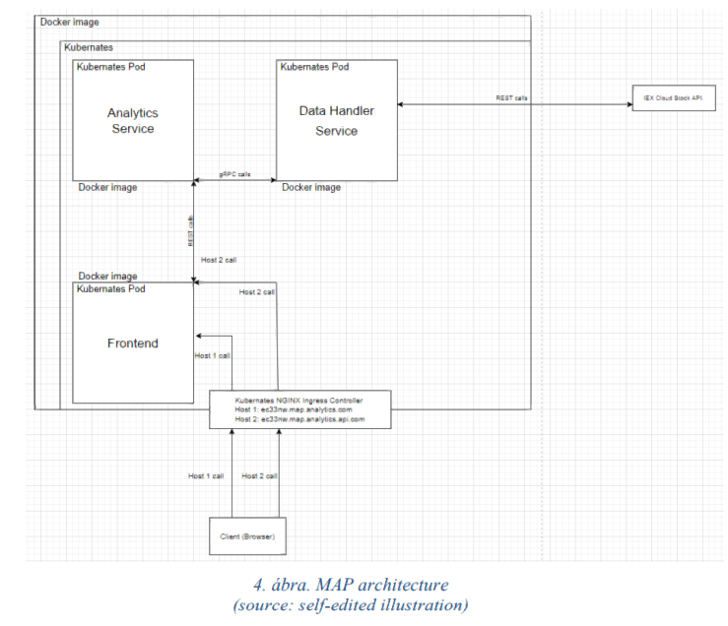
Analysis I. Architecture
All components are standalone microservices, each having its own Dockerfile, as well as the relevant Deployment and Service configuration .yaml files for the cluster.

Slide 5
Analysis II. Datahandler
responsible for all tasks related to data integrations
currently integrates only with the IEX Cloud API, through a 3rd party client library:
Supported methods: getSymbols, getBalanceSheets, getIncomeStatements, getCashflowStatements, getPeers
datasource of the MAP, host of gRPC server in the cluster
data conversions from the POJOs coming from the IEX Cloud API to gRPC objects via custom mapping & reflection
issues with special generated grpc classes, NoParam type and DecimalValue type

Slide 6
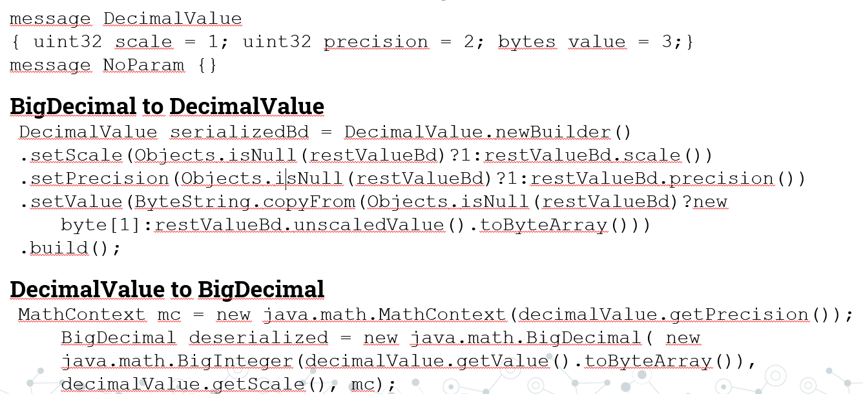
gRPC example

Slide 7
Analysis III. Analytics
responsible for data analytics, integration with the Frontend
currently it only supports Frontend integration
it should provide a REST API towards the Frontend
provide an OpenAPI specification to the Frontend
Mapstruct to map the gRPC data to POJOs

Slide 8
Analysis IV. Frontend
responsible for requesting and displaying data, and providing an interface to the user.
Frontend's API clients generated with Swagger from Analytics.

Slide 9
Analysis IV. Frontend
features:
toolbar with 2 menu items (open valuation definition, generate report)
generate a report that shows all information
display competitor company symbols
display the searched company's financial statements
valuation metrics storing place
dialog box remains open in case of multiple company searches
Add button to execute the basic mathematical operations requested
Search field with autocomplete

Slide 10
Technologies
MAP
Minikube
each service will have its own Docker image, available on my Dockerhub: https://hub.docker.com/u/zedas
Analytics and Datahandler services:
microservice implementations in Java 8
Spring Boot as a DI framework
built by Maven (dependency management feature to resolve the required gRPC, Sprint Boot, Swagger, Mapstruct, and IEX Cloud Client API dependencies/ plugins
Eclipse IDE

Slide 11
Technologies
Frontend:
Angular, Angular Material component library
Swagger to generate the REST API clients from the Analytics service
the services handling the REST API clients using RxJS
Visual Studio Code IDE
npm as the package manager

Slide 12
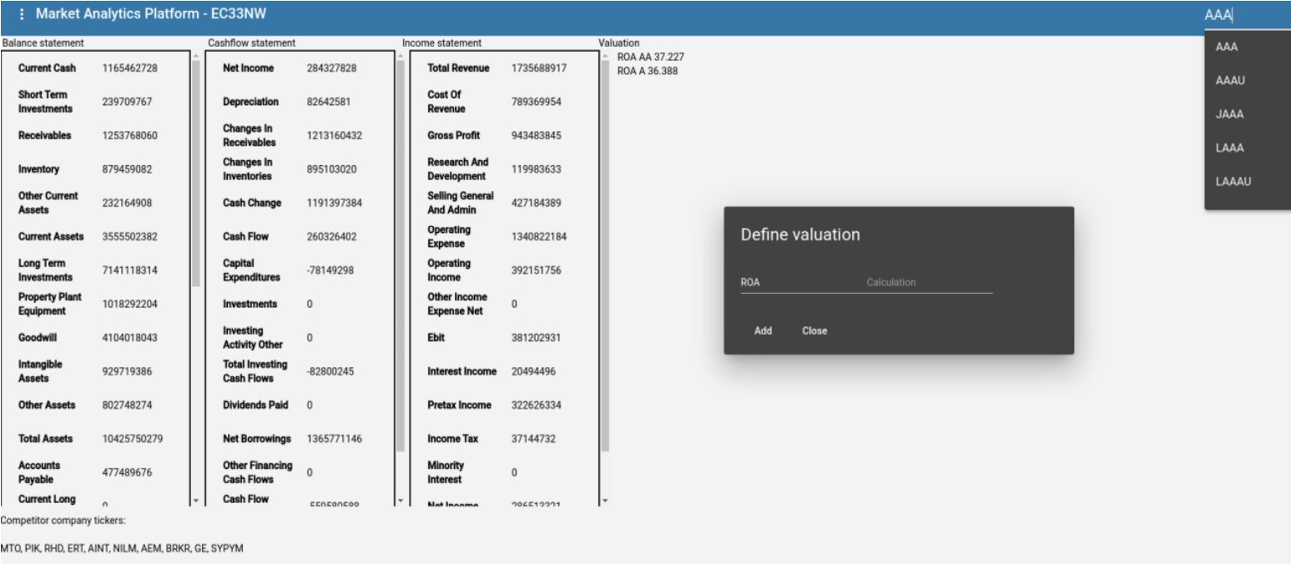
Completed product

Slide 13
A bíráló által megfogalmazott észrevételek ismertetése
1.) A címben szereplő „alpha” érték, illetve ennek értelme nagyon nincs elmagyarázva. Mi ennek a definiciója?
2.) Teljesen más értelemben előkerül az „alpha” szó a szakdolgozatban is szereplő K8S –szel kapcsolatban is (Alpha cluster). Hol kerül elő és mit jelent a fogalom?
Notes:
Alpha is a measure of the active return on an investment, the performance of that investment compared with a suitable market index. An alpha of 1% means the investment‚s return on investment over a selected period of time was 1% better than the market during that same period; a negative alpha means the investment underperformed the market.
Alpha clusters are short-lived clusters that run stable Kubernetes releases with all Kubernetes APIs and features enabled. Alpha clusters are designed for advanced users and early adopters to experiment with workloads that take advantage of new features before those features are production-ready.

Slide 14
Summary
MAP has demonstrated a small step towards a more value focused financial technology concept
more sustainable way of investing
lightweight, modern technologies
building on Kubernates from day one
it is possible to perform financial analysis and reporting on multiple companies to some degree on the platform
can be developed further on many angles

